Slide 1
Client Requirements
SHARE
Learning Objectives
Understand how to interpret client requirements
Key Words
EXPECTED PROGRESS
BETTER THAN EXPECTED PROGRESS

Slide 2

Who is the client??
LEARN
Your client is the person you will be working for. They will tell you what they want you to plan, design or create for them
The client will set out requirements that they want you to follow when you plan the project
Client requirements include:
Target audience
Colour scheme
Timescale – deadlines for the project
Purpose
Content (information & images)
Budget – how much money there is to spend
Style/genre
What you are creating (TV advert, magazine advert, game etc)

Slide 3
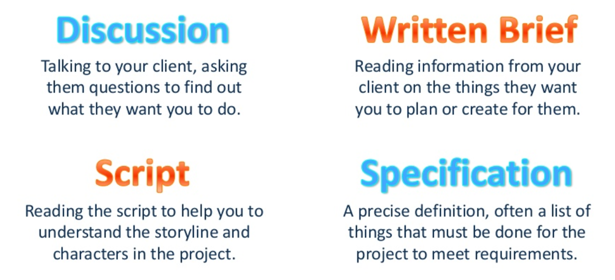
How can you find your client’s requirements?

Slide 4
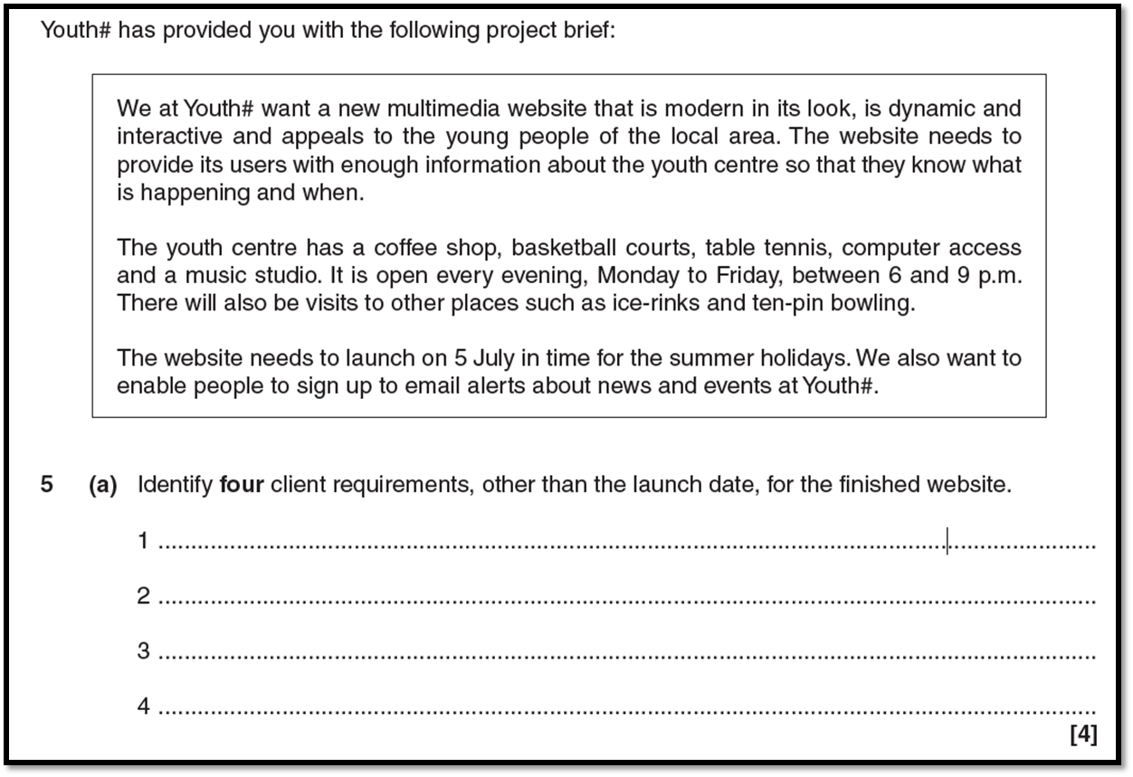
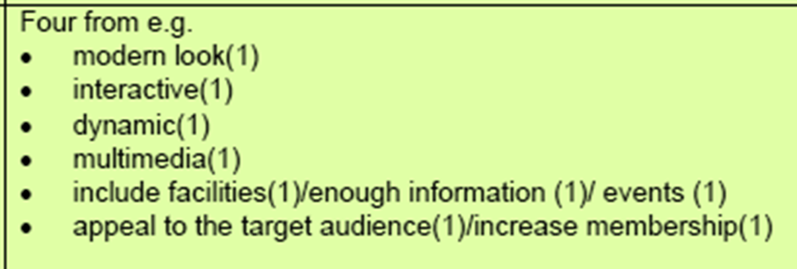
Exam Practise Complete Q1

